Slide 1
REST RESTful Web Services
Jakub Klímek, Martin Nečaský
This work is licensed under a Creative Commons Attribution 4.0 International License.

Slide 2
What is REST?
REST = REpresentational State Transfer
Roy Fielding dissertation, 2000
software architectural style for building distributed hypermedia (hypertext) systems
set of following architectural principles
resource orientation
unique resource identification
stateless client/server interaction
uniform interface
e.g. Web architecture is based on the same principles as REST
but REST principles were derived from the architecture of the Web
A truly RESTful API looks like hypertext.

Slide 3
Principle 1: Resource Orientation
resource = concrete or abstract thing/action we want to publish
everything is resource in REST
resource representation ~ state of the resource
document that can be sent between communicating peers
representation format needs to be established
different (meta-)formats may be used
HTML, XML, JSON, RDF, AtomPub, …
each resource can have more representations, in different formats
data formats == media types
representation contains links to related resources
representation format must support links
applications which consume resources navigate instead of calling
navigation = transition to next state
Most commonly forgotten

Slide 4
Principle 2: Unique Resource Identification
each resource has unique ID (name)
universal syntax for resource IDs is necessary, e.g. URI
ID serves not just as a name but also as a means of accessing resource representation, URL
parametrized IDs http://www.company.org/customer?name=John
need to distinguish resource ID from resource representation ID e.g. HTML, XML, JSON, RDF documents
if resource = document then resource ID = resource representation ID
otherwise we need strategy to allow clients to request specific resource representation

Slide 5
Principle 3: Stateless Client/Server Communication
request/response message exchange pattern
separation of concerns principle
clients separated from servers by interface
clients are not concerned with data storage and (most) application logic
servers are not concerned with user interface or state
server simplicity and scalability
independent evolution of clients and server

Slide 6
Principle 3: Stateless Client/Server Communication
stateless communication
no state in server-side applications
state in clients and/or resources
resource state is the same for every client
client changes to resource state affect all other clients
client state is specific for each particular client
communication state
cacheable responses
reponses labeled as cacheable and non-cacheable

Slide 7
Principle 4: Resource Manipulation
uniform interface for resource manipulation
small set of operations which apply for everything
e.g. CRUD operations (Create, Retrieve, Update, Delete)
small set of verbs which apply to large set of nouns
if many applications need new verb, uniform interface can be extended
do not encode verbs into resource identifiers
http://www.company.org/addCustomer?name=John

Slide 8
REST != HTTP
REST specification does not include implementation directives
It does not say to use HTTP
Any implementation honoring the principles is RESTful
Everything is a resource, identified and accessed using URI
Simple, well-defined operations on resources (CRUD)
Client and server exchange representations of resources using standardized interface and protocol
Resources decoupled from their representation
to allow clients accessing it in variety of formats = media types
Every interaction is stateless

Slide 9
REST using HTTP: Resource ID - direct dereferencing
direct dereferencing
resource ID is not dereferencable
client has to know particular resource representation IDs
e.g.
https://api.twitter.com/1.1/statuses/user_timeline.json
https://api.twitter.com/1.1/statuses/user_timeline.xml

Slide 10
REST using HTTP: Resource ID - content negotiation
dereferencing using HTTP 303 See Other response code
resource ID is dereferencable
two requests
client requests resource ID and specified preferred resource representation format
server sends resource representation ID in 303 response
client requests resource representation ID

Slide 11
REST using HTTP: Resource ID
Server
GET /customer?name=John
Host: www.company.org
Accept: text/xml
client
Server
HTTP/1.1 303 See Other
Location: http://www.company.org/customer.xml?name=John
client
Server
GET /customer.xml?name=John
Host: www.company.org
Accept: text/xml
client

Slide 12
REST using HTTP: Resource ID
how to set-up 303 URIs?
e.g. Apache HTTPD (.htaccess file)
RewriteCond %{HTTP_ACCEPT} application/rdf\+xml
RewriteRule ^customer customer.rdf [R=303]
http://www.company.org/
customer?name=John
http://www.company.org/
customer.rdf?name=John

Slide 13
REST using HTTP: Resource ID - Clean URLs
avoid parameterized resource ID
i.e. use
http://www.company.org/customer/John
instead of
http://www.company.org/customer?name=John
RewriteCond %{HTTP_ACCEPT} application/rdf\+xml
RewriteRule ^customer/([a-zA-Z]+)$ customer.rdf?name=$1

Slide 14
REST using HTTP: HTTP Verbs
when HTTP is used, the following four operations are usually considered:
GET = requests representation of the specified resource
read-only operation, should be safe = should not cause any side-effects
PUT = uploads representation of the specified resource
write operation, should be idempotent
being idempotent means being simple = identical request causes the same state change independently of how many times it has been called
DELETE = deletes the specified resource
write operation, should be idempotent
POST = submits data to be processed to the specified resource
it can update the resource
generally not safe and not idempotent

Slide 15
Richardson Maturity Model - RMM
Hypermedia
HTTP
URI
https://restfulapi.net/richardson-maturity-model/

Slide 16
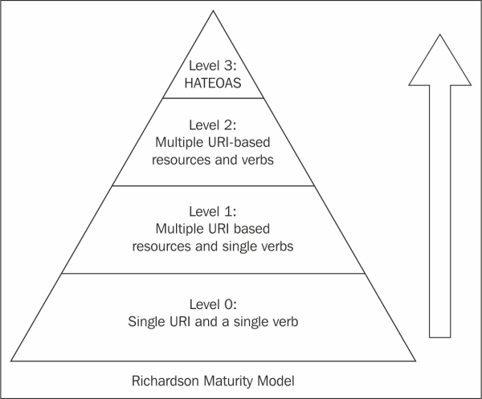
Richardson Maturity Model - RMM
https://restfulapi.net/richardson-maturity-model/
Notes:
Same principles, different visualization

Slide 17
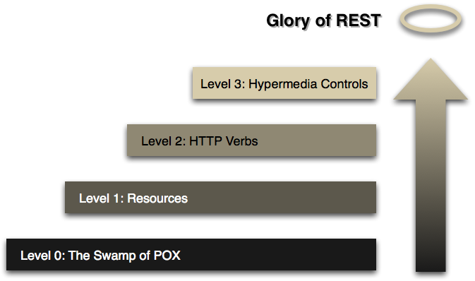
Richardson Maturity Model - RMM
https://martinfowler.com/articles/richardsonMaturityModel.html
Notes:
Same principles, different visualization
POX = Plain Old XML

Slide 18
RMM - Level 0 WS
Single URI - like WS-* endpoint
Single verb - like WS-* POST to send SOAP
e.g. XML-RPC
Plain Old XML (POX)
1 URI
1 verb - POST
Use HTTP as a tunneling mechanism (like RPC)

Slide 19
RMM - Level 0 WS - example - 1/3
See free slots to see a doctor
POST /appointmentService HTTP/1.1
[various other headers]
<openSlotRequest date="2010-01-04" doctor="mjones"/>
HTTP/1.1 200 OK
[various headers]
<openSlotList>
<slot start="1400" end="1450">
<doctor id="mjones"/>
</slot>
<slot start="1600" end="1650">
<doctor id="mjones"/>
</slot>
</openSlotList>
Notes:
Endpoint: /appointmentService
Verb: POST

Slide 20
RMM - Level 0 WS - example - 2/3
Book the appointment - success
POST /appointmentService HTTP/1.1
[various other headers]
<appointmentRequest>
<slot doctor="mjones" start="1400" end="1450"/>
<patient id="jsmith"/>
</appointmentRequest>
HTTP/1.1 200 OK
[various headers]
<appointment>
<slot doctor="mjones" start="1400" end="1450"/>
<patient id="jsmith"/>
</appointment>
Notes:
Endpoint: /appointmentService
Verb: POST

Slide 21
RMM - Level 0 WS - example - 3/3
Book the appointment - failure
POST /appointmentService HTTP/1.1
[various other headers]
<appointmentRequest>
<slot doctor="mjones" start="1400" end="1450"/>
<patient id="jsmith"/>
</appointmentRequest>
HTTP/1.1 200 OK
[various headers]
<appointmentRequestFailure>
<slot doctor="mjones" start="1400" end="1450"/>
<patient id="jsmith"/>
<reason>Slot not available</reason>
</appointmentRequestFailure>
Notes:
Endpoint: /appointmentService
Verb: POST

Slide 22
RMM - Level 1 WS
Makes use of URIs
Each resource has a URI
Single verb
like W3C-style WS-* POST to send SOAP

Slide 23
RMM - Level 1 WS - example - 1/2
See free slots to see a doctor
POST /doctors/mjones HTTP/1.1
[various other headers]
<openSlotRequest date = "2010-01-04"/>
HTTP/1.1 200 OK
[various headers]
<openSlotList>
<slot id="1234" doctor="mjones" start="1400" end="1450"/>
<slot id="5678" doctor="mjones" start="1600" end="1650"/>
</openSlotList>
Notes:
Access to each resource
Doctor is a resource
Each slot is an individually addressable resource
Verb: POST

Slide 24
RMM - Level 1 WS - example - 2/2
Book the appointment
POST /slots/1234 HTTP/1.1
[various other headers]
<appointmentRequest>
<patient id="jsmith"/>
</appointmentRequest>
HTTP/1.1 200 OK
[various headers]
<appointment>
<slot id="1234" doctor="mjones" start="1400" end="1450"/>
<patient id="jsmith"/>
</appointment>
Notes:
Access to each resource
Doctor is a resource
Each slot is an individually addressable resource
Anyone can post to the appointment resource, like test schedule...
Verb: POST

Slide 25
RMM - Level 2 WS
Makes use of URIs
Each resource has a URI
HTTP verbs used for CRUD
Create
Read
Update
Delete

Slide 26
RMM - Level 2 WS - example - 1/3
See free slots to see a doctor
GET /doctors/mjones/slots?date=20100104&status=open HTTP/1.1
Host: royalhope.nhs.uk
HTTP/1.1 200 OK
[various headers]
<openSlotList>
<slot id="1234" doctor="mjones" start="1400" end="1450"/>
<slot id="5678" doctor="mjones" start="1600" end="1650"/>
</openSlotList>
Notes:
GET - safe method, idempotent, does not change anything significant
Therefore, can be cached

Slide 27
RMM - Level 2 WS - example - 2/3
Book the appointment - success
POST /slots/1234 HTTP/1.1
[various other headers]
<appointmentRequest>
<patient id="jsmith"/>
</appointmentRequest>
HTTP/1.1 201 Created
Location: slots/1234/appointment
[various headers]
<appointment>
<slot id="1234" doctor="mjones" start="1400" end="1450"/>
<patient id="jsmith"/>
</appointment>
http://royalhope.nhs.uk/slots/1234/appointment
Notes:
The same request as Level 1
Response uses the 201 HTTP response code + location in case of success
https://restfulapi.net/http-status-codes/

Slide 28
RMM - Level 2 WS - example - 3/3
Book the appointment - failure
POST /slots/1234 HTTP/1.1
[various other headers]
<appointmentRequest>
<patient id="jsmith"/>
</appointmentRequest>
HTTP/1.1 409 Conflict
[various headers]
<openSlotList>
<slot id="5678" doctor="mjones" start="1600" end="1650"/>
</openSlotList>
Notes:
The same request as Level 1
Response uses for example the 409 HTTP response code in case of problems
It is up to the designer to choose which codes to use for what

Slide 29
RMM - Level 3 WS
Makes use of URIs
HTTP verbs used for CRUD
HATEOAS
Hypertext As The Engine Of Application State
Hypermedia controls
Some people pronounce it as "hate-ee-os," similar to "hideous," or as "hate O-A-S".
People also refer to it as a hypermedia-driven system.

Slide 30
RMM - Level 3 WS - example - 1/2
See free slots to see a doctor
GET /doctors/mjones/slots?date=20100104&status=open HTTP/1.1
Host: royalhope.nhs.uk
HTTP/1.1 200 OK
[various headers]
<openSlotList>
<slot id="1234" doctor="mjones" start="1400" end="1450">
<link rel= "/linkrels/slot/book"
type="POST"
href="/slots/1234"/>
</slot>
<slot id="5678" doctor="mjones" start="1600" end="1650">
<link rel= "/linkrels/slot/book"
type="POST"
href="/slots/5678"/>
</slot>
</openSlotList>
Notes:
Same request as on Level 2
The difference is we now know how to book an appointment - links
Hypermedia controls tell us what to do next

Slide 31
RMM - Level 3 WS - example - 2/2
Book the appointment
POST /slots/1234 HTTP/1.1
[various other headers]
<appointmentRequest>
<patient id="jsmith"/>
</appointmentRequest>
HTTP/1.1 201 Created
Location: http://royalhope.nhs.uk/slots/1234/appointment
[various headers]
<appointment>
<slot id="1234" doctor="mjones" start="1400" end="1450"/>
<patient id="jsmith"/>
<link rel="/linkrels/appointment/cancel"
href="/slots/1234/appointment"/>
<link rel= "/linkrels/appointment/addTest"
href="/slots/1234/appointment/tests"/>
…
</appointment>
Notes:
Same request as on Level 2
Links to other operations
Server developers can change URI schemes without breaking clients
Developers can explore the protocol
Server can advertise new capabilities

Slide 32
REST API
Must be hypertext driven
3rd level RMM is only a prerequisite for REST
Any URI has to be usable for resource identification
No fixed URI patterns
REST API cannot change communication protocols
For resource representation, REST API should
define media type(s)
define extended relation names
define extended markup for existing standard media types
RESTful API should be usable with only
initial URI
set of standardized media types

Slide 33
RESTful Web Services
RESTful Web Service
enables manipulation with set of resources
typically uses XML, JSON or RDF for resource representation
uses URLs as resource identifiers
stateless
HTTP methods GET/PUT/DELETE/POST for resource manipulation
like Web application but for machines instead of humans

Slide 34
RESTful Web Services: typical HTTP verb meanings
Operation | Resource representing collection of individuals | Resource representing individual
GET | List members in collection e.g. weekly list of public contracts | Retrieve individual e.g. retrieve public contract
PUT | Update collection with another one e.g. replace weekly list of public contracts at the beginning of new week | Update individual e.g. update public contract representation with new representation
DELETE | Delete entire collection e.g. delete weekly list of public contracts | Delete individual e.g. delete public contract
POST | Create member of collection with auto-ID e.g. add new public contract to the collection and generate its ID | Create part of individual e.g. create public contract tender

Slide 35
REST vs. SOAP - The letter analogy
mailing a letter with SOAP (W3C-style WS)
you're using an envelope
with REST
it's a postcard
postcards are easier to handle
by the receiver
waste less paper
i.e., consume less bandwidth
have a short content
of course, REST requests aren't really limited in length
esp. if they use POST rather than GET

Slide 36
REST vs. SOAP
SOAP and REST – both provide support for building SOA based applications
Dimension | REST | SOAP (W3C-style WS)
Underlying Protocol | REST is an architecture style Almost synonymous to HTTP Not enforced by specification | SOAP itself is a protocol Mainly over HTTP But also over SMTP, …
Data Format | Any format: JSON, CSV, RSS, XML, … | XML
Statefulness | Stateless | Stateless
Caching | Using infrastructure already in place Uses caching related HTTP headers for GET, PUT, DELETE ETags
HTTP Verbs | GET, POST, PUT, DELETE, PATCH | POST
Security | TLS (HTTPS) (point to point) | WS-Security (end to end)
Asynchronous Processing | HTTP 202 Accepted response + Location of queue | WS-Reliable Messaging
Notes:
Generally speaking, W3

Slide 37
WADL
Web Application Description Language
W3C Member Submission, 2009
XML-based description of HTTP-based web applications

Slide 38
WADL - example
<application xmlns="http://wadl.dev.java.net/2009/02"> <resources base="http://example.com/api"> <resource path="books"> <method name="GET"/> <resource path="{bookId}"> <param required="true" style="template" name="bookId"/> <method name="GET"/> <method name="DELETE"/> <resource path="reviews"> <method name="GET"> <request> <param name="page" required="false" default="1" style="query"/> <param name="size" required="false" default="20" style="query"/> </request> <response status="200"> <representation mediaType="application/xml"/> <representation mediaType="application/json"/> </response> </method> </resource> </resource> </resource> <resource path="readers"> <method name="GET"/> </resource> </resources> </application>
@base - base URI for child resource identifiers
@path - relative URI template
methods available on the resource
query parameters
response types

Slide 39
WADL - parameter styles
<resource path="reviews"> <method name="GET"> <request> <param name="page" required="false" default="1" style="query"/> <param name="size" required="false" default="20" style="query"/> </request> </method> </resource>
query - go into request URI after "?"
http://example.com/api/books/1234/reviews?page=1&size=20
header - go into HTTP header
template - go in resource paths
{bookID}
matrix - go into request URI before query, separated by ";"
http://example.com/api/books/1234/reviews;page=1;size=20

